Slide 1
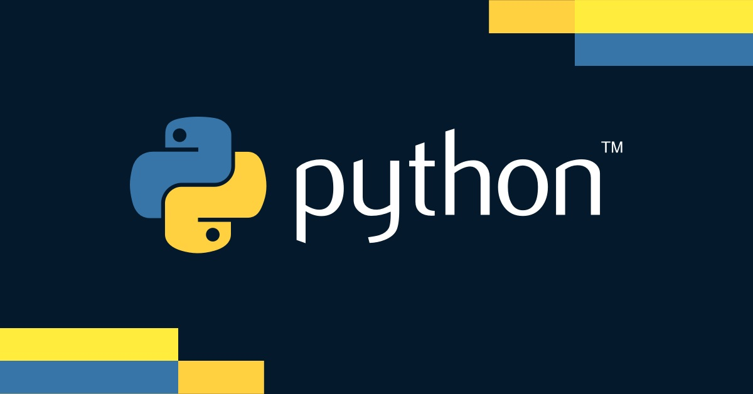

Slide 3
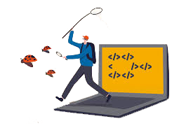
Introduction to Debugging and Testing
What is Debugging?
Finding and fixing mistakes (bugs) in your code
What is Testing?
Checking if your code works as expected
Why is it Important?
Makes your code reliable
Saves time by catching problems early

Slide 4
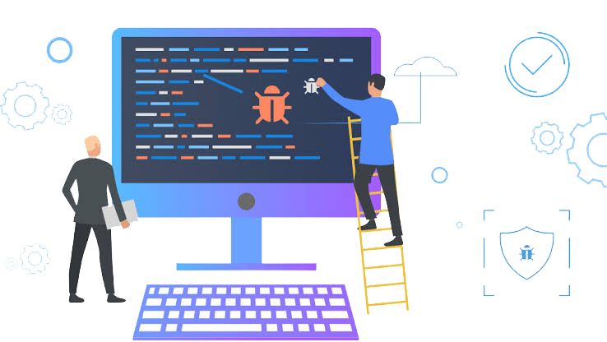
Common Debugging Techniques
Print Statements
Use print() to see what your code is doing
Using an IDE Debugger
Tools in your coding software that help find bugs
Python Debugger (pdb)
A built-in tool for step-by-step debugging

Slide 5
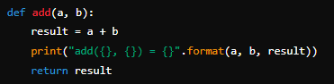
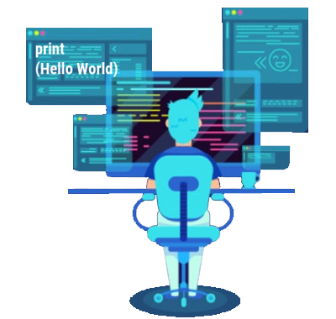
Using Print Statements
Example
Pros
Easy to use
Cons
Can make your code messy

Slide 6
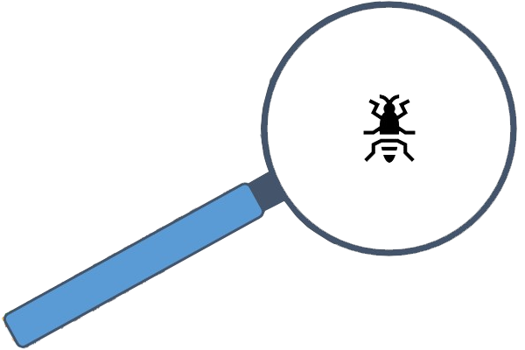
Debugging with IDE Debuggers
Breakpoints
Pause your code at a specific line
Step Over/Into
Step Over
Skip over functions
Step Into
Go inside functions to see details
Inspecting Variables
Check the values of your variables
Examples of IDEs
PyCharm, Visual Studio Code

Slide 7
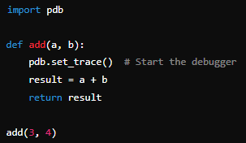
Using Python Debugger (pdb)
break
Set a breakpoint
continue
Resume running the code
Example
step
Go into a function
next
Go to the next line
print
Show variable values

Slide 8

Introduction to unittest
What is unittest?
A built-in Python module for testing
Why use it?
Helps you write tests for your code
Makes sure your code works correctly

Slide 9
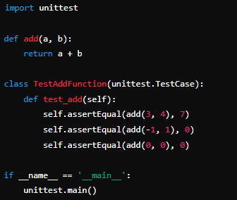
Creating a Simple Test Case
Example
Explanation
Import unittest
Define a function to test
Create a test class
Write test methods using assertEqual

Slide 10
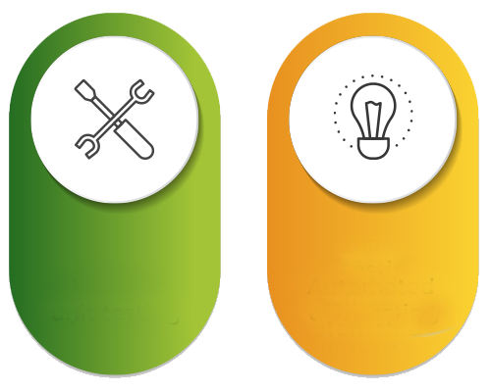
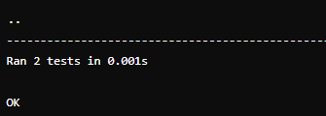
Running Tests with unittest
Command Line
Run your tests by executing the script: python test_script.py
Output
Shows which tests passed and which failed
Example Output

Slide 11
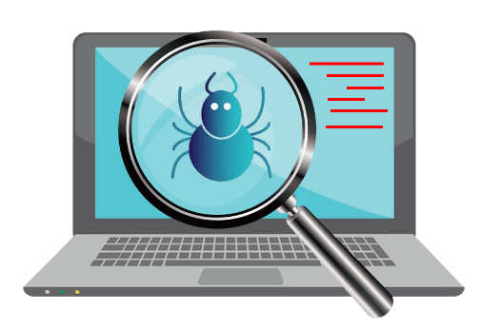
Tips for Effective Debugging and Testing
Start Small
Test small pieces of your code first
Be Organized
Test one thing at a time
Automate Tests
Use unittest to run your tests automatically
Document and Refactor
Write down what you find and fix

Slide 12

What is debugging?
Finding and fixing errors in code
Which function can be used to print variable values for debugging?
print()
What does the command pdb.set_trace() do?
Starts the Python debugger
What is a breakpoint?
A place where code is stopped for debugging

Slide 13
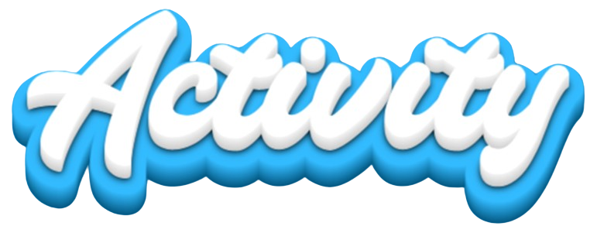
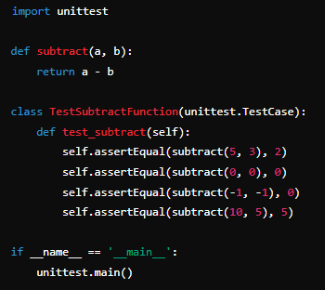
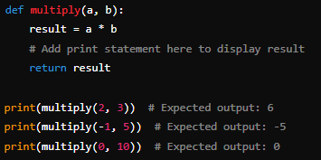
TASK 1
Use print statements to debug a simple function
TASK 2
Write a simple test case using unittest
to test the subtract function

